Slide 1
Final project
By Keira, Hannah, Khanh, Sebastian and Kevin.

Slide 2
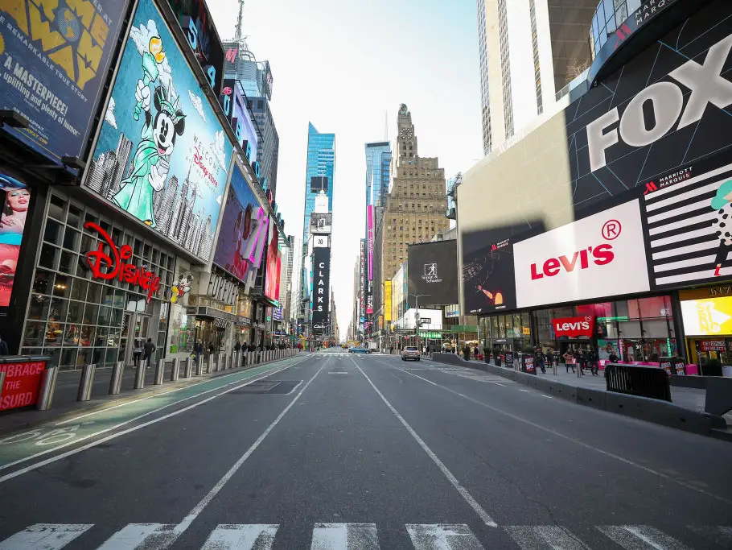
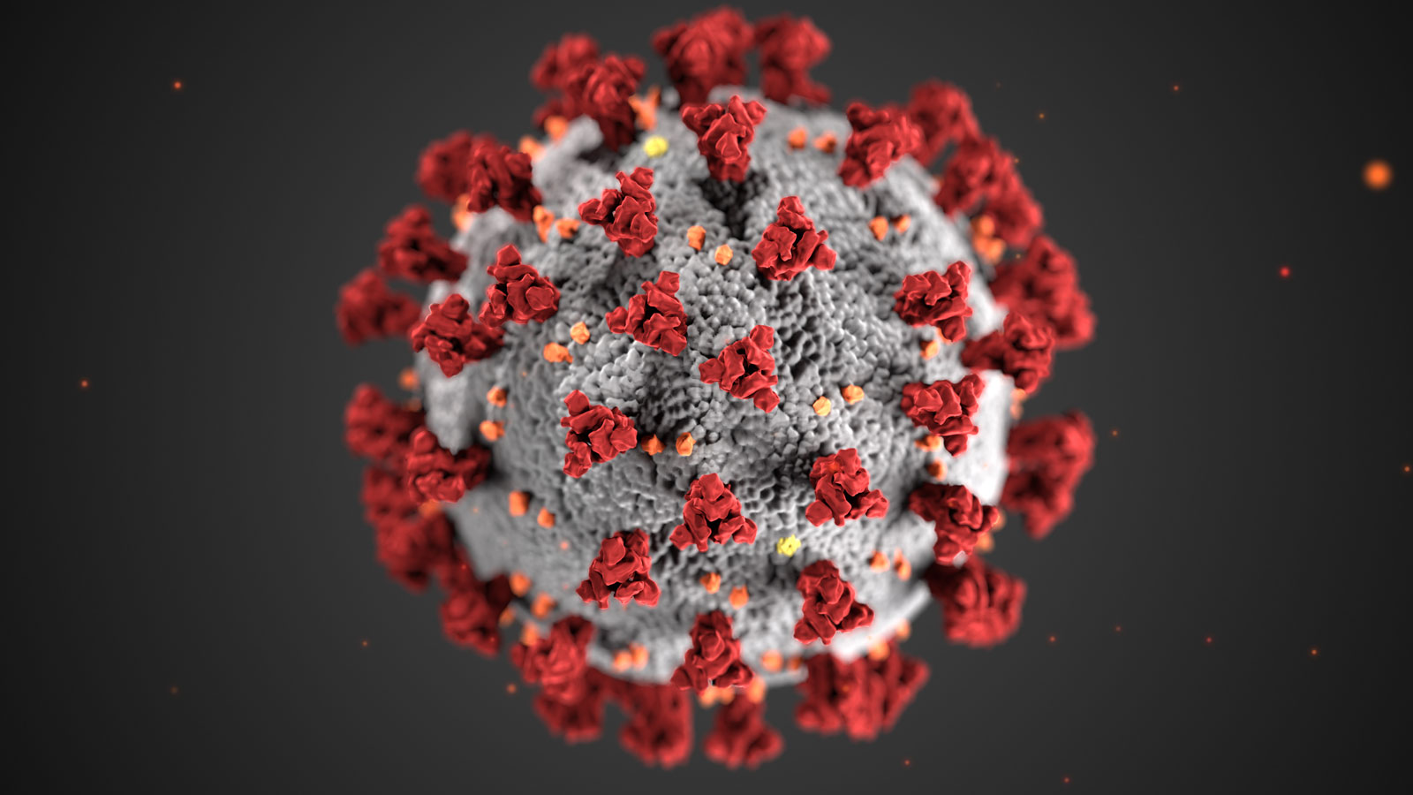
Overview of the problem

Slide 3
Data Sources and description
We got data from US census, Kaggle, and other sources
Lots freely available data
Spent a long time trying to find nicely formatted data to reduce data cleaning
Looked at 8 or so data sets, ended up using 4 of them
Covid and covid vaccination data from Kaggle
Income, gender, and race data from OpenIntro
Voting patterns from GitHub
Notes:
Voting patterns had all kinds of information from which county voted for which candidates to the method of voting to
But we ended up just using the point difference column, which gave the difference between the votes dem and republican - this does ignore third party candidates, but
The open intro data did also have historical data, but we only looked at the most recent, 2019 data - obviously if the pandemic changed that data it wouldn’t be reflected, but it gives us a sense of where every country was at the start of the pandemic, has education data, transport, income, race, how its changed over time, insurance, retail sales

Slide 4
Data cleaning
We chose data that was relatively clean to begin with but we still:
Made sure the types were correct
Different county naming styles
Combined all the data from our different source into one big list that only had the data that might be relevant
Checked for missing values (a few null values lead us to look for different data sets)

Slide 5
EDA
We created graphs for all the variables
Deleted variables with high correlation with one another(or keep one)
If two variables have high correlation, adds greater emphasis to both in the prediction.
For example, the percent of genders
Notes:
We created graphs for all the variables we planned to use in our dataset in order to analyze trends and distinguish which variables could be eliminated as outliers. We also looked for variables in our data that had a high correlation with one another. We would delete one of those variables because two variables with a high correlation will add a greater emphasis in the variables, which can change the results in the prediction. For example, we noticed that having a percentage for females and males was unnecessary, so we took out the female variable to prevent skewing the data.

Slide 6
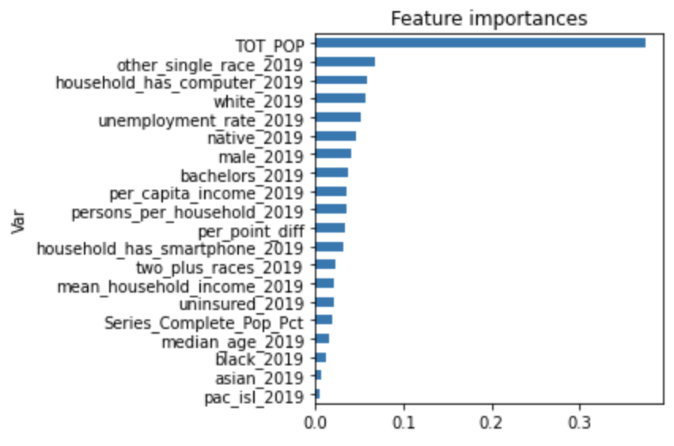
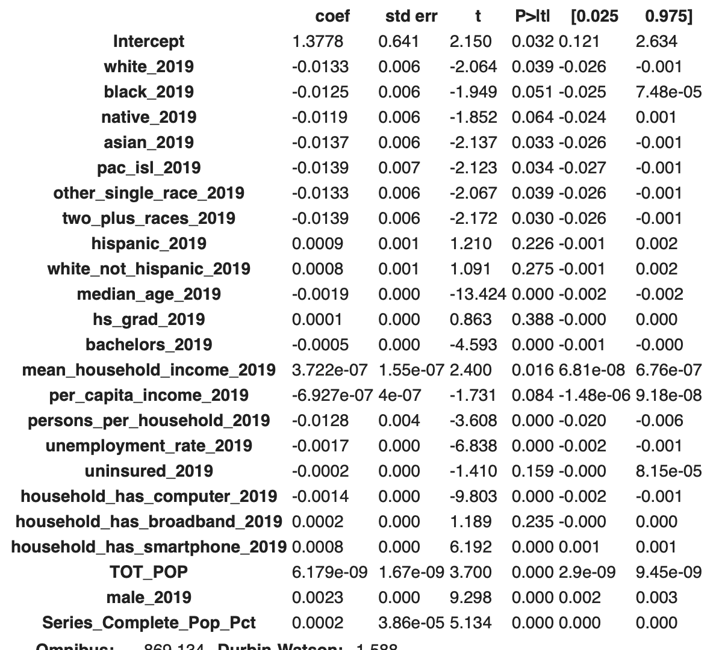
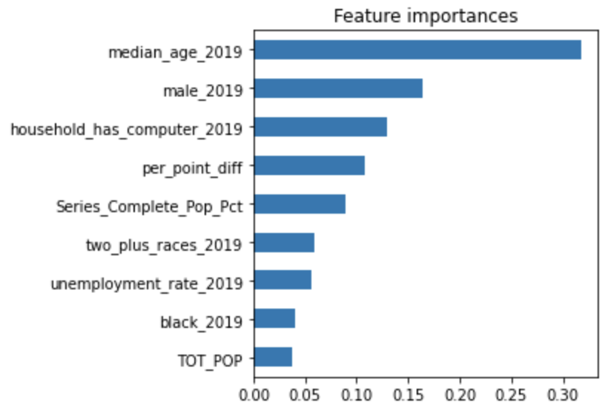
Feature engineering

Slide 7
Modeling
cases_per_capita = average_cases_in_the_us + 0.00509923male -
0.01245196median_age - 0.00765377household_has_computer + 0.00840073per_point_diff + 0.00561966vaccinated_pop - 0.00171684two_plus_races - 0.00227221unemployment_rate + 0.00296562black + 0.0025961tot_pop

Slide 8
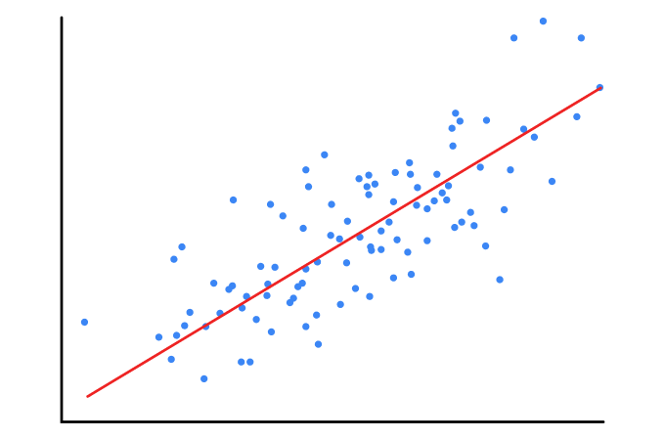
Different models we tried

Slide 9
Effect of each factor on cases per capita
% Population Male
Median Age
% households with computers
People voting Republican
% of Population Vaccinated
% Multiracial people
Unemployment rate
% Black people
Total Population

Slide 10
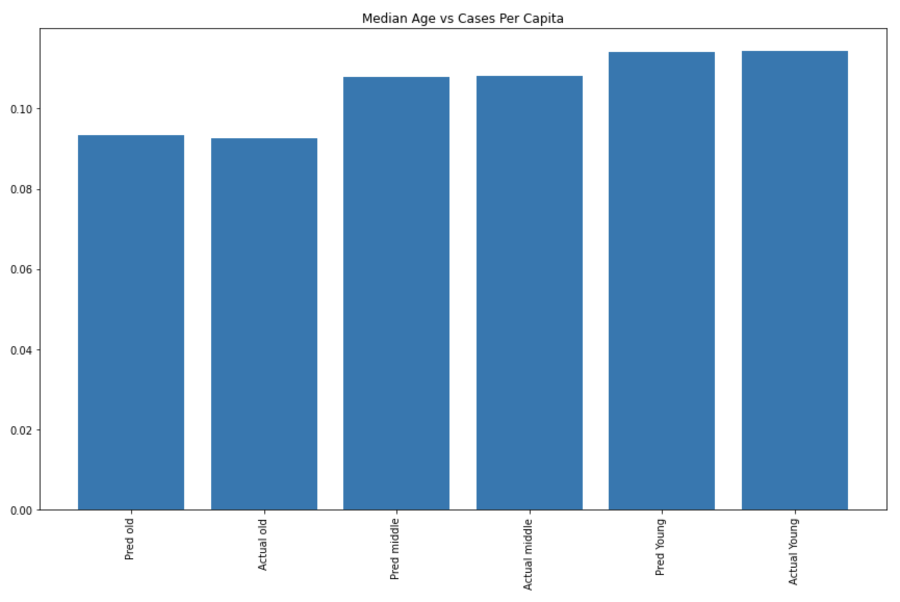
Age

Slide 11
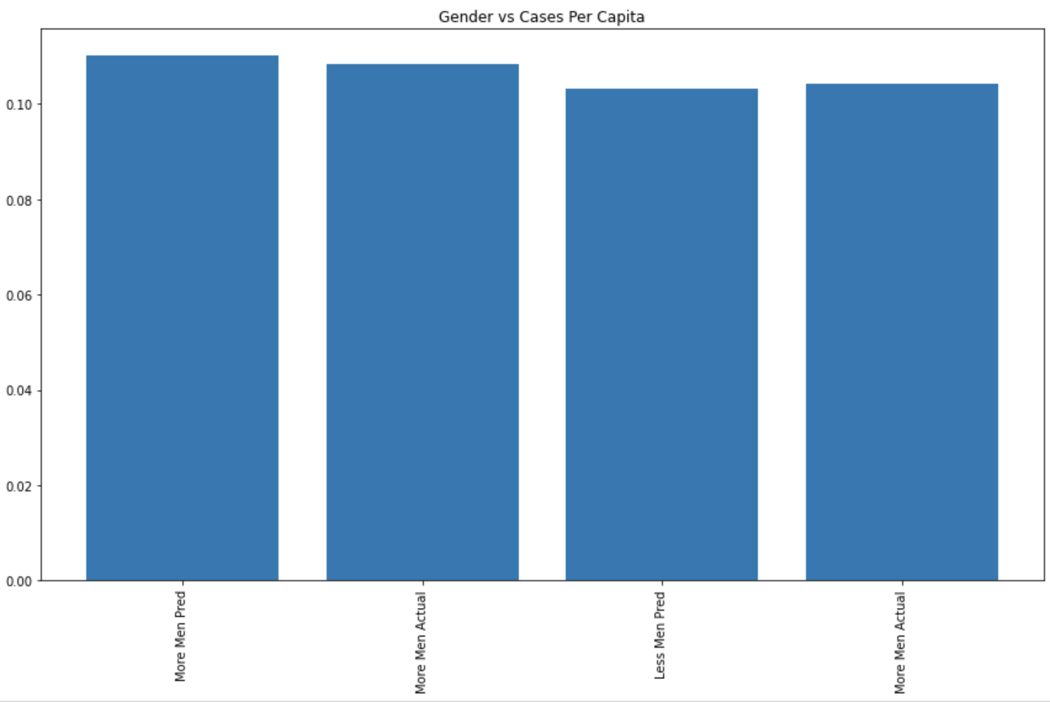
Gender

Slide 12
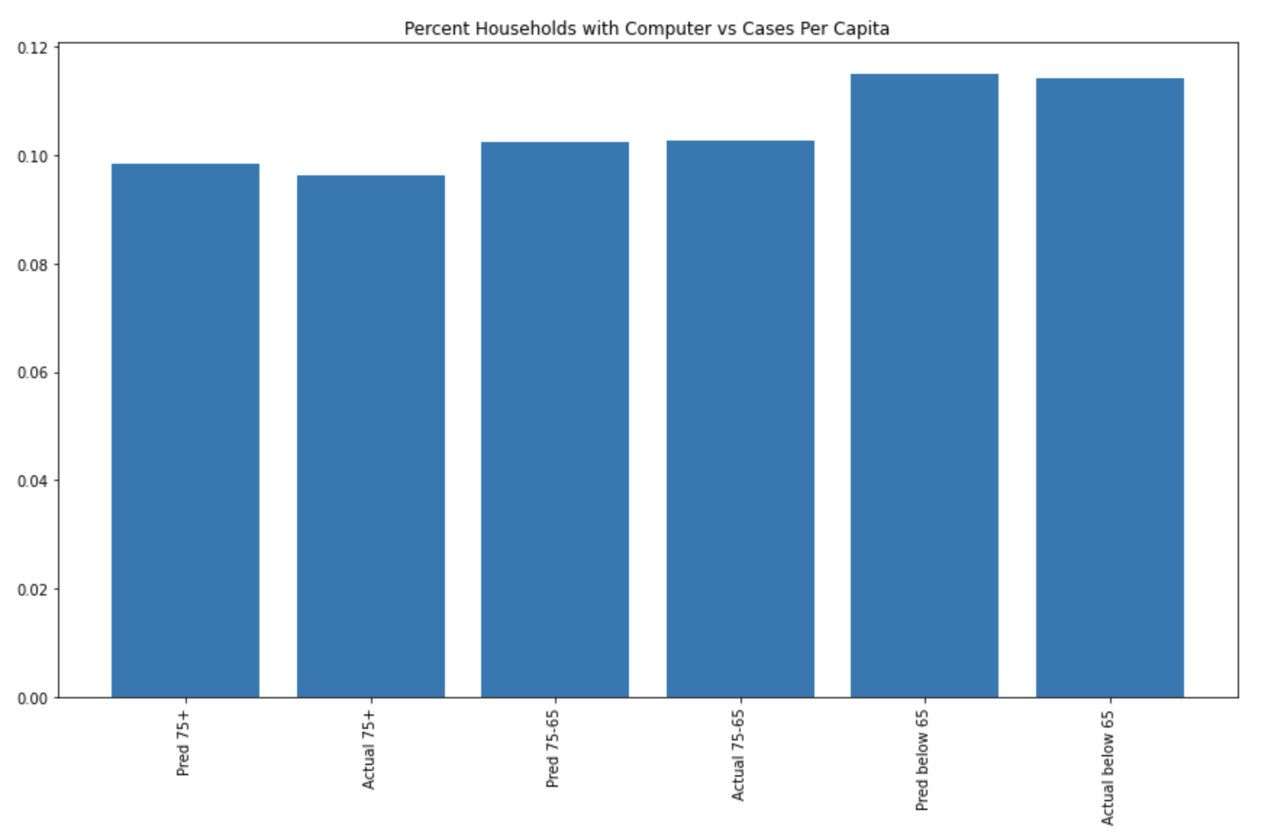
Households with Computers

Slide 13
Next steps/ further investigations
Our model assumes that the next pandemic will be exactly the same as COVID 19
The data is very relative: averages can be swayed based on different times when COVID could be more or less dangerous
Further investigate factors that will be consistent no matter what the disease is
Try and create a model that can predict different diseases
Predict possible changes in population or overall income in different counties
Try and use datasets for past pandemics instead of just the COVID pandemic
We need to find more data and possibly understand why some variables lead to less COVID cases; for example % household with computers and % unemployment rate

